Slide 1
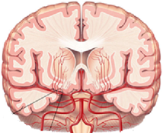
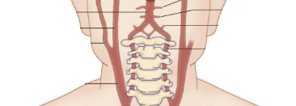
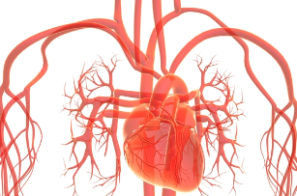
Health and Ageing what is your future? and can you change it? Updated 16.08.2015 by Dr Peter Wright Neurologist and Stroke Physician for general use to assist patients and whanau to understand optimal healthy living as far as the limited scientific literature can guide us.

Slide 2
Estimated effect on years to live
Married +2
Professional +2
Exercise (hi vs minimal) +4.5
SDAdventist vegetarian +7
Education (uni vs <12yrs) +9
Adult calorie restriction +11 (theory)
Perfect vs terrible Risk +15 (at 50)
(BP, Chol, Obese, Smoke, No Job, Poor)
Cholesterol (best vs worst) -2
Obesity -4
BP (best vs terrible) -5
Depression -4F to -6M
Smoking -6.5
Obesity+inactivity -7
Smoke+BP+Cholesterol -10yrs (at 50)
Diabetes –type 2 -10
Obesity+smoking -14

Slide 3
Stroke Prevention Lifestyle
9x Healthy Advice
-------------------------------------------------------------------------------------
Fruit/Veges 5+ serves / day
Flax seed 3 Tbspn/day
Mediterranean diet
Nuts 30gm/day
Olive oil 4 Tbsn/day
Exercise 30-60 mins puffing/sweating 5-6 x / week
Weight loss BMI 18.5-25.0, waist <93cm (M), 79cm (F)
Fish 3+ per week
Dark Chocolate 1-2 squares/day
Potassium 120mM/day
Alcohol 100ml (F) – 150ml wine (M) / day

Slide 4
Stroke Prevention Lifestyle
6xUnhealthy Advice
-------------------------------------------------------------------------------------
No Smoking stop
No Drugs stop
No Boozing small amounts
No meat-fats/frying/ low dairy-fat if needing statin (LDL<1.8)
No Salt if BP>120/80, <200mg sodium/serving
none table/kitchen, avoid licorice
Less Red Meat/Pork 1-2 serves/week; use poultry instead

Slide 5
Smoking
smoking ages risk of stroke/MI/death by 10 yrs
smoking increases risk by 1.9x
By 1 year smoke free the risk is 1.5x
By 2 years 1.3x
By 5 years ~1x

Slide 6
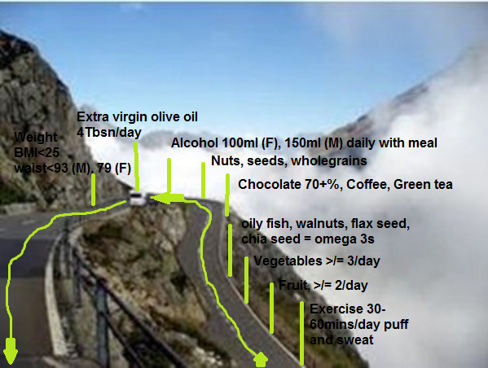

Slide 7
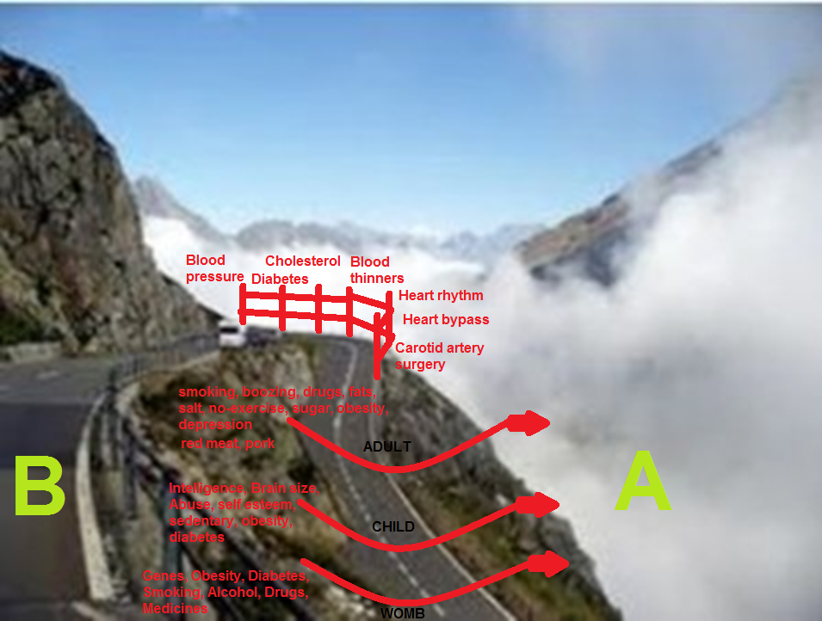

Slide 8
Vascular Health: latest evidence
PREDIMED = Mediterranean diet 2013
Randomised controlled trial
Adventist Health Study 2: 2013-14
Prospective large cohort of vegetarianism
CSPPT: Folate for stroke prevention
JAMA March 2015
Ubble (Lancet June 2015)
Huge prospective mortality predictors
Association not causation

Slide 9
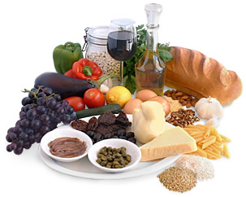
Mediterranean Diet

Slide 10
Finally 2013! First time we’d had proOF you can change your vascular future
PREDIMED: a great trial of average age 50-80, 7000 subjects with “high risk” but no stroke or heart attack. Followed for 5 years

Slide 11
Go Mediterranean 2 trials; stopped early
Secondary prevention after MI (584 people)
Lyon Diet Heart Study Lancet 1994 and Circulation 1999
MI+CVevent+CVdeath @4yrs → 34% → 10% Risk down by 67%
Primary (high risk) prevention (>7000 people) PREDIMED; NEJM Feb26 2013;
Stroke+MI+death↓ 4.4% → 3.6%; Risk down by 30%
Stroke (nuts cohort) 2.5 % → 1.4% @ 5yrs; Risk down by 46%
This is as good as blood pressure medication trials
HOPE (very high Risk + ACEi) Stroke 4.9% → 3.4%; Risk down by 32%
PROGRESS (Prior stroke/TIA) Stroke 3.8% → 2.7%; Risk down by 28%
NEJM 2000 Lancet 2001

Slide 12
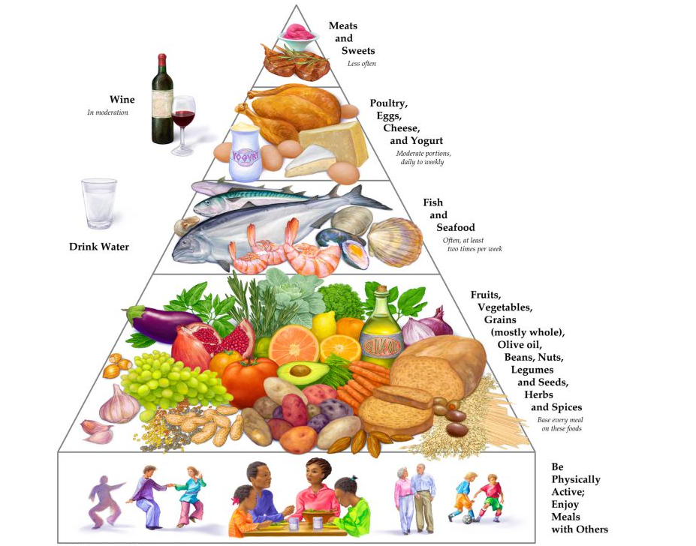
Mediterranean Diet

Slide 13
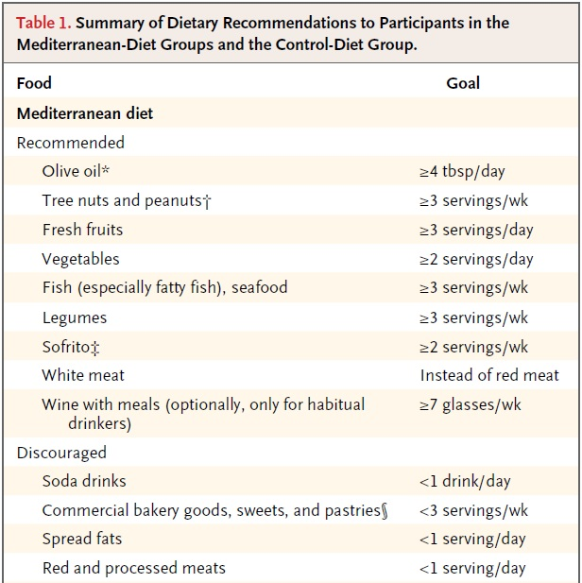
My comments, based on this and other studies
extra virgin olive oil (or canola??)
handful esp walnuts
any but esp citrus, pipfruit > berries
cruciferous > root veges
beans/peas
tomato, onion, garlic, oil
margarines, butter (use oil)

Slide 14
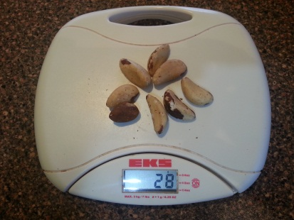
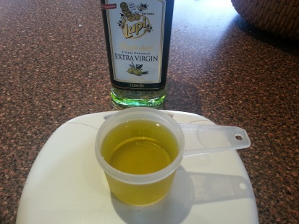
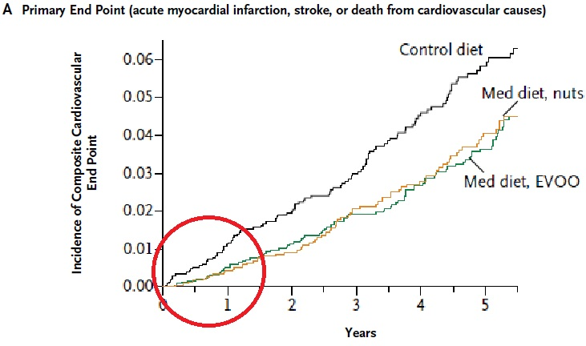
Mediterranean Diet
Daily or
Benefit especially in
Hypertensives p=0.06
Hyperlipidaemics p=0.06
Obese p=0.05

Slide 15
Mediterranean also prevents dementia
REGARDS Study 2003–2007: Adherence to a Mediterranean diet and risk of incident cognitive impairment Georgios Tsivgoulis, MD, Neurology April 30, 2013 vol. 80 no. 18 1684-1692
Mediterranean Diet and Brain Power measured at baseline and yearly for 4 years
cognitive impairment developed in 7%
Mediterranean diet group→ especially in non-diabetics → 20% (1/5th) less risk of brain power loss (p = 0.007)

Slide 16
SDAdventist Vegetarian Diet?

Slide 17
SDAdventists and longevity/diet
96,000, 2/3 F, 1/5 black, age 57, most = SDA
2002-5 (73,000 FU x 5.8yrs)
adjusting for age, race, sex, smoking, exercise, education, marital status, alcohol, geographic region, menopause, and hormone therapy

Slide 18
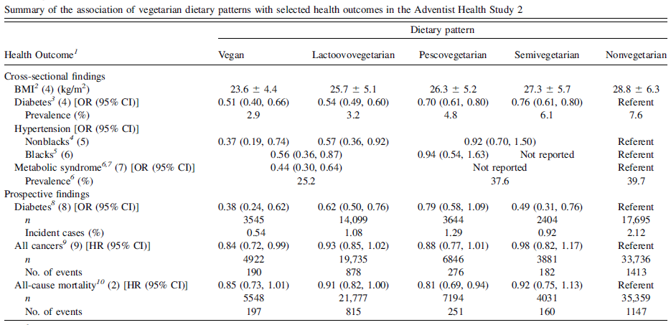
SDAdventists and longevity/diet

Slide 19
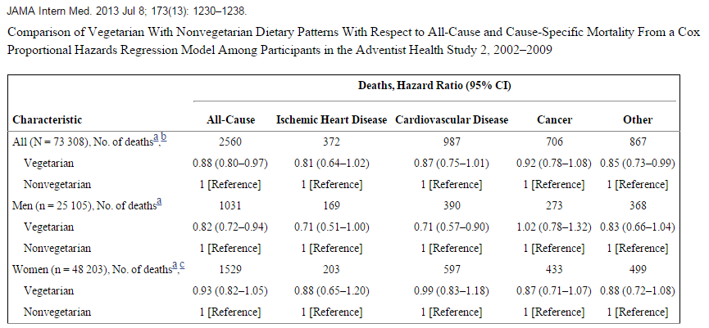
SDAdventists and longevity/diet
Results (not included in table) for stroke were for men, 0.83 (0.52–1.31); and for women, 1.27 (0.89–1.80).

Slide 20
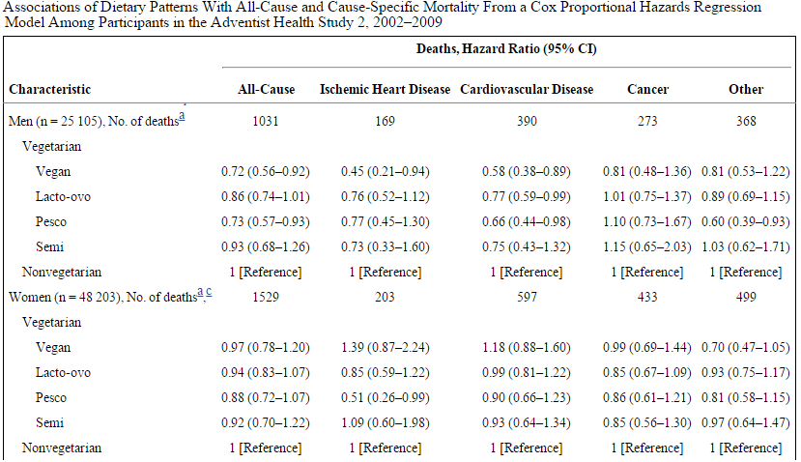
SDAdventists and longevity/diet

Slide 21
CPPST JAMA March 2015 Folate given to Chinese (age ~60, all with raised blood pressure) over 4 years and looking for effect on Stroke
Ideally, adequate folate levels would be achieved from food sources such as vegetables (especially dark green leafy vegetables), fruits and fruit juices, nuts, beans, and peas.

Slide 22
RCT Enalapril +/- Folate 0.8mg/day
20,000 people in China
MTHFR gene type (deals with folate)
If low folate, good genes, treatment reduced strokes 4.4 →2.0% 4yr. No gain if Folate >11
If bad genes (TT, starting homocysteine ~15) then Folate dose inadequate to reduce stroke except if folate >9 then 4.1%→1.9% (RRR 54%)

Slide 23
RCT Enalapril +/- Folate 0.8mg/day
My conclusions for healthy living
Treating lowish folate is highly effective in stroke prevention
Treating normal folate if Homocysteine is >/=15 is likely highly effective
Treating aggressively lowish folate where homocysteine is high may assist

Slide 24
UBBLE June 2015 massive hunt for mortality causes

Slide 25
2015 Breakthrough data: UBBLE (www.ubble.co.uk/available for your interest) = provides associations only, no clear evidence that certain choices will help
500,000 people in the UK
655 risk factors assessed
aged 37–73 years
UK Biobank from April, 2007, to July, 2010
5 year mortality (and other outcomes)

Slide 26
2015 UBBLE women (the relative odds of dying over 5 years is given next to the activity. ie 0.5 means half the risk, and 3 means 3 times the risk)

Slide 27
2015 UBBLE healthy women all-mortality
Top 10 factors = smoke related - STOP
Face looks old 3x young
Walk slowly 2x briskly
Pulse rate <60 1.5
Don’t live with parents 1.4
Tea 1-3x/d (none 1.3)
Coffee 1-3/d 0.9, decaf or ground 0.9
Beef 0.5-4x/wk (daily 1.6x)
Cheese 1-4x/wk (daily 1.1)
Lamb <1/wk (daily 1.2)
Pork <1/wk (daily 4)
Oily fish 2-4x/wk (none 1.3, daily 1.9)
Poultry 2-6x (<1x 1.2, daily 1.9)
Exercise (0.6x), avoid complete laziness (3x)
Exercise 1-2hr sessions (none 2.5x )
Cycle transport (0.4x), strenuous sport (0.5x)
Get fit together (no sport club/gym 2x )
Use the stairs heaps (no stairs 2x)
Light DIY 2-3x/wk (none 2x). Heavy ~ 1 hr
(none 3.5x, or >3hrs), 1-3x/wk
Walk 4-7days/wk (0.4x), 20-30mins
Vigorous exercise 2-4days/wk, <1hr/time
Spreads olive- or flora proact (butter 1.5)
Wholegrain bread (white 1.4)
Skim milk or soy (full cream 2)
Fruit >1/d 0.8; raw salad/vege >4 Tbs/d 0.8
Veges cook 2-8 heaped Tbs/d 0.9
Muesli (0.7x weetbix, 0.5x cornflakes)
Salt added always 1.5

Slide 28
UBBLE women VASCULAR-mortality
Sleep 6-7hrs/night avoiding >>8hrs
Avoid regular siestas (3x never)
Bounce out of bed (2.5x)
Drink alcohol none = 2x, gave up = 3x
Alcohol 3-4x/wk 0.7
Red wine 2-6 glass/wk 0.3
White wine >2/wk 0.4
Beer/cider 0-2/wk, Spirits <1/wk
Cancers+Etoh wine 0.8-0.9, beer/cider 1.2
Waist <87cm (versus >103 = 3x)
TV 0-1hr/day (1.5x 2-3, 2x 3-5 4x>5hrs/day)
Avoid loneliness (2x), Social group (2x)
Enjoy activities(3x), stay happy (3x)
Boost your energy (3x daily tiredness)
Have a youthful face (4x older than age)
Keep up your mobile phone use (2x less use)
Don’t be a stickler for motorway speedlimits (2x)
Get outside in summer (4.5x not), usu block/hat

Slide 29
UBBLE men (the relative odds of dying over 5 years is given next to the activity. ie 0.5 means half the risk, and 3 means 3 times the risk)

Slide 30
UBBLE healthy men all cause-mortality
Top 10 risks are smoking related – STOP
Weak grip strength 3x (not for women)
Exercise 0.5
Be fully employed 36-50hrs, don’t retire young
Rich 0.5, house (0.2-0.5), 2+ cars (0.25 x none)
Fish 1-4x/wk (none 1.4, daily 1.6)
Poultry 1-4x/wk (<1 1.3x, daily 1.7)
Beef 0-1x/wk (2-3x 1.3, >5x 2.5)
Lamb <1x/wk (>2x/wk 1.5)
Cheese have it, none = 1.4
Pork <1x/wk, huge increase 5+/wk = 3.5
Processed meats <1x/wk (2x daily)
Walk for pleasure > 3hrs, 1-10 x/fortnight
Vigorous exercise 2-3d/wk 30-60m or >3hr
Sleep 6-7hrs/night, avoid >>8hrs
Avoid regular siestas
Bounce out of bed in mornings
Full of energy (mostly exhausted 3-4x)
Look younger than your age (2x look older)
Do not avoid motorways,
+ sometimes speed
Red wine 3-4day/wk, with meal, 3-6/wk 0.3
Avoid 5+ hrs TV/day (0-1hrs best)
Outdoors sun, usu (not always) protected
Stay engaged / happy (mostly unhappy 2-2.5x )

Slide 31
UBBLE healthy men all cause-mortality
Live with >4 in house (3.3x younger only)
BP ?122-142 / >73
BMI <23.6 (age <54) <31 (age <70)
Waist 78-97 (>103cm 5x), Hip 96-101cm (2.6x)
Pulse<60/minute (>80 = 2x)
Vascular Mortality
Drink alcohol, none = 1.6
Red wine >2 glass/wk 0.6 vs none 1.2
White wine 2-6/wk 0.6 vs none 1.5
Avoid fortified wines 1.6
1-3cups ground coffee/d 0.7
Spreads rarely olive oil based > butter (1.5-2x)
Muesli 0.5 , Porridge (0.7x cornflakes), >/= 4x/wk
Wholegrain/meal bread (white 1.5x)
Minimise salt (usually add 1.3, always 1.7)
Fruit >2/d 0.7, Dried fruit unlimited, (none = 2x)
Cooked vege 2-3/d, Raw vege 2-4 heapTbs 0.7
Soya or skimmed milk (0.7x full cream)
3-5cups tea/d 0.9
Walking pace slow = 7-9 x brisk
Exercise, none = 3x, not every day
Go up /down stairs all day 0.5 (<60yo)
Walk for pleasure >3hrs occ = 0.6
Strenuous sport 2-3x/wk 0.5
Vigorous Exercise 2-4d/wk 0.7,
Exercise 30-60m/dose 0.7
Heavy DIY >1x/FN 30-60 mins (none 2x)

Slide 32
Now on to Stroke and Lifestyle No other high quality studies exist to indicate what we should be doing to minimise risk!

Slide 33
Prevention of Stroke: 90% less??
Interstroke Lancet 2010

Slide 34
Avoidable Stroke Risks: how strong is the risk?
Risk of stroke increased 2x
smoking, cholesterol, hardened arteries, The Pill, lack of exercise
obese, B vitamins lack, Gum disease, some bugs, acute infection, low birth weight baby, family history
Risk of stroke increased 4x
Diabetes (2-6), Heart Rhythm, Illegal drugs(2-5)
Risk of stroke increased 6x
Blood pressure

Slide 35
Blood pressure and Stroke fixing blood pressure = single most important risk factor
Reduce Diastolic (bottom number) BP by 3mmHg → ↓stroke by 33%
Reduce Systolic (top number) BP 1-2%→↓stroke 16%
= Achieved by 15% less salt
What can you do? Meta-analysis of studies says… (J Hypertens 2006)
BP improvement
Very low salt (age 55+) 7 mmHg
Exercise 7/5 mmHg
High Potassium diet 6/4 mmHg
Weight loss 1kg=1mmHg
Etoh restrict 3.8mmHg
Fish oil 2.3mmHg
Dark Chocolate 2-3mmHg?
Stop smoking helps
Feigan, ISC 2013, Lancet 1998

Slide 36
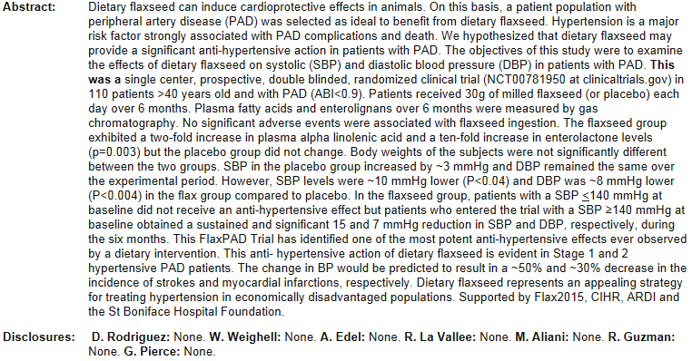
Flaxseed (“linseed”) and lower BP

Slide 37
High potassium diet
analyses of trials
reduced systolic blood pressure by 6/4 mmHg (21 trials)
average potassium consumption in many countries is below the recommended 80 mmol/day
risk of stroke 30% less when the intake of potassium was 90-120 mmol/day (analysis of nine cohort studies)
Aburto N J et al. BMJ 2013;346:bmj.f1378
Aburto N J et al. BMJ 2013;346:bmj.f1378
Notes:
Fig 4 Association between higher potassium intake and risk of incident cardiovascular disease, stroke, and coronary heart disease in adults

Slide 38
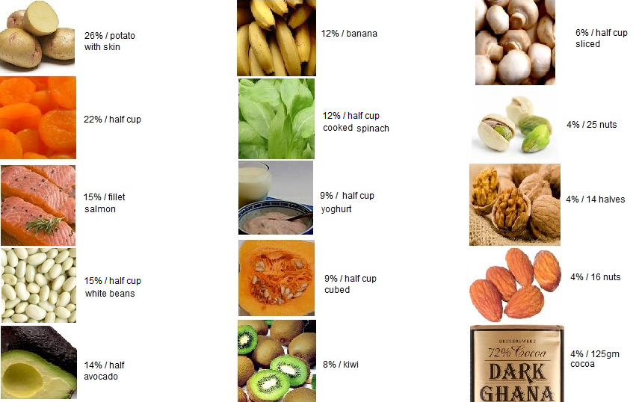
potassium and foods
(% of recommended daily intake)
Notes:
Fig 4 Association between higher potassium intake and risk of incident cardiovascular disease, stroke, and coronary heart disease in adults

Slide 39
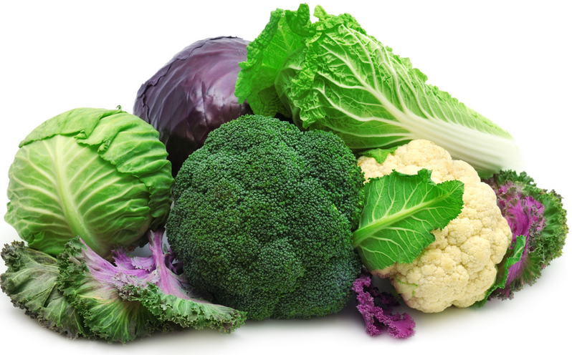
Fruit and Veges and Stroke?
FYI these are the cruciferous veges (good for stroke prevention)

Slide 40
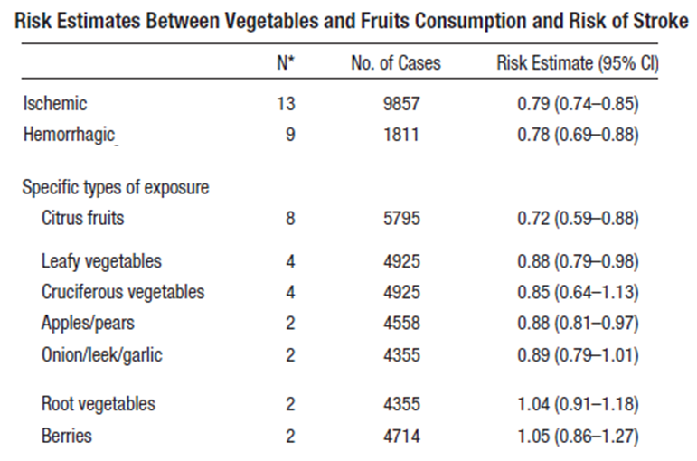
Fruit and Veges
21% less
28% less
Notes:
Fig 4 Association between higher potassium intake and risk of incident cardiovascular disease, stroke, and coronary heart disease in adults

Slide 41
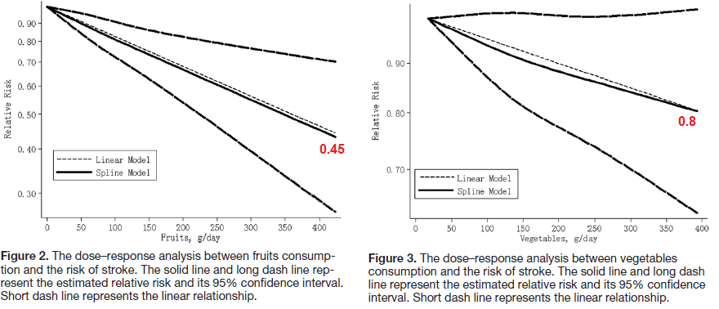
Fruit and Veges
55% less stroke
from 400gm fruit per day
20% less stroke
from 400gm veges per day
Notes:
Fig 4 Association between higher potassium intake and risk of incident cardiovascular disease, stroke, and coronary heart disease in adults

Slide 42
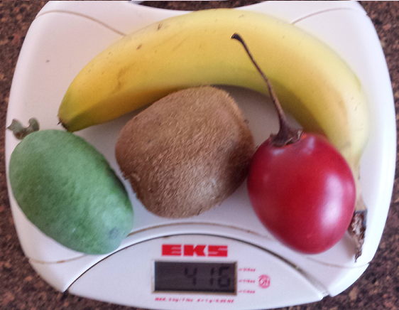
Fruit 400mg / day
Notes:
Fig 4 Association between higher potassium intake and risk of incident cardiovascular disease, stroke, and coronary heart disease in adults

Slide 43
Cannabis; NZ issue
Urine Cannabinoids in ED, associated with 2.3x risk of stroke
The following are known issues with cannabis
Heart attack within 1hr of smoking pot ↑ 5x
Irregular heartbeat (Afib)
Sudden cardiac death
Brain arteries spasm (1/3 of all cases)
Young stroke (3/4 of cases)
Barber, ISC, 2013

Slide 44
That’s all on stroke prevention, but what about your general health?

Slide 45
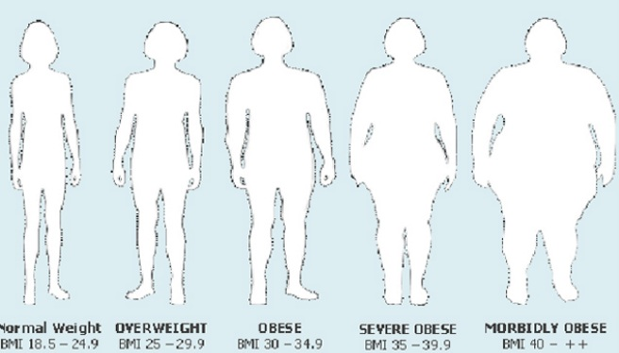
the tsunami sweeping the nation

Slide 46
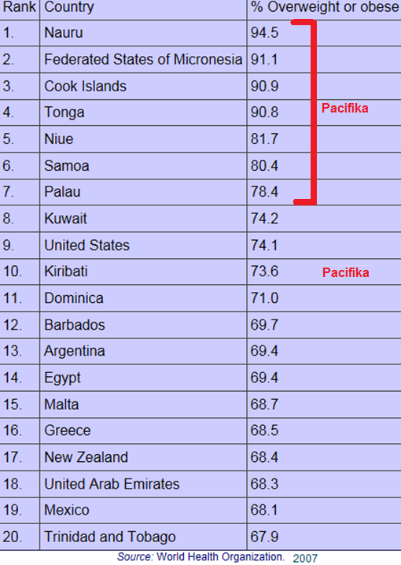
New Zealand is amongst the fattest in the world

Slide 47
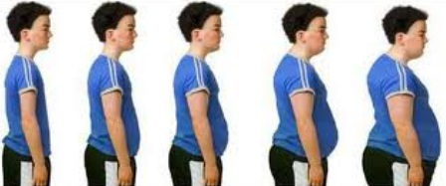
and the Waikato is now officially the fattest part of New Zealand?

Slide 48
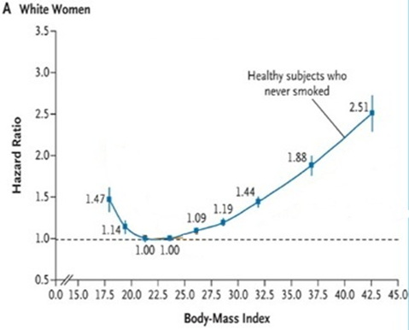
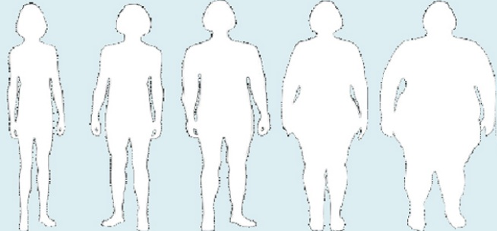
Obesity and the risk of early death?
Anorexia
is bad !

Slide 49
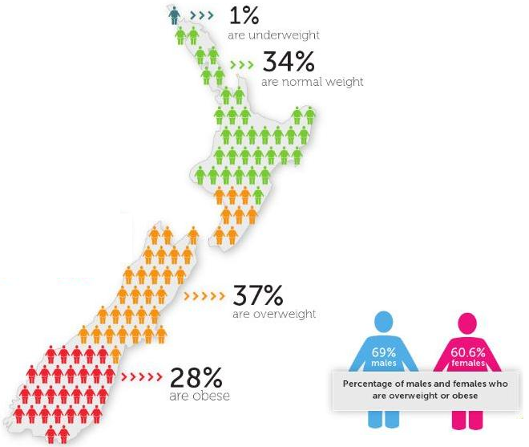
Only 1 in 3 are in a healthy weight

Slide 50
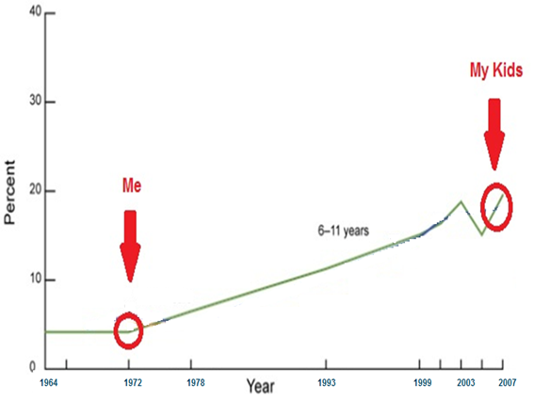
and it is worsening in kids, FAST !
Data from USA over 45 years

Slide 51
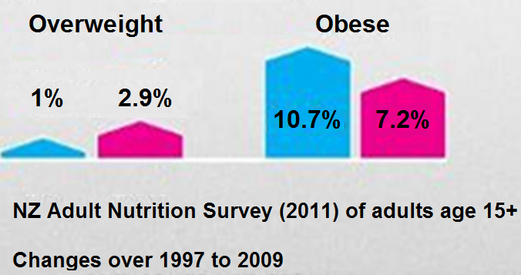
and it is worsening, in NZ! blue=boys, pink=girls (of course)

Slide 52
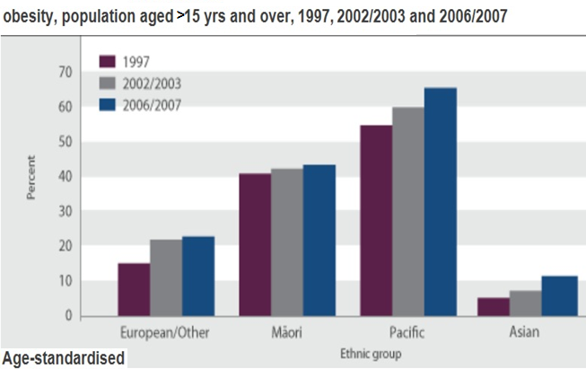
NZ major ethnic differences, but all are worsening

Slide 53
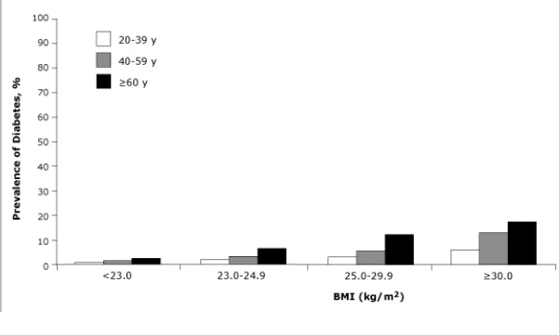

Slide 54
Having diabetes is linked to dementia
3000 older people ~70 yr old followed for 9 years
23% had diabetes, and another 5% developed it during followup.
(diabetes in NZ climbs by 5-10% each decade=obesity linked)
Diabetics had lower brain power, and the gap widened over 9 years
“New diabetes” fell in between the a) diabetics and b) non-diabetics
worse diabetes control (HbA1c) was associated brain power loss
Health ABC project, Archives Neurology 2013, Yaffe et al

Slide 56
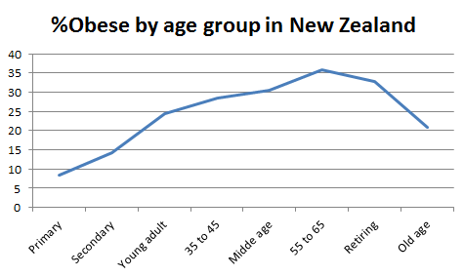
and we just keep growing outwards (MOH, 2006/7)

Slide 57
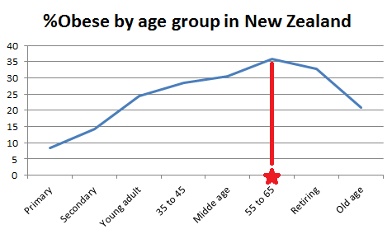
and obese people are dying off around retirement

Slide 58
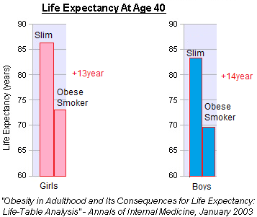
Obesity and smoking = even worse

Slide 59
Exercise

Slide 60
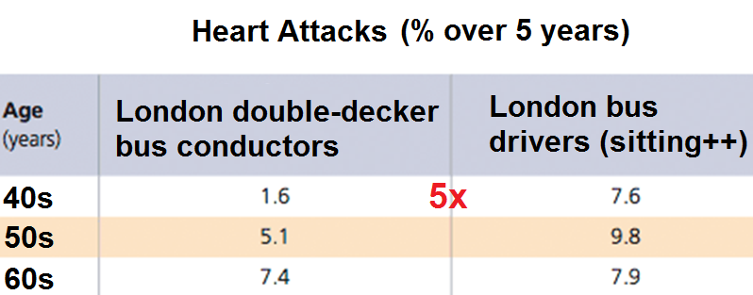
Don’t be a couch potato
Lancet 1966; 2(7463): 553-9

Slide 61
not even an “active couch potato”
Sitting >23hrs versus <11hrs per week
→risk of dying of heart disease = 3x higher
→even in exercisers
→ipads, computers, TVs, long commutes and sedentary jobs are all bad news

Slide 62
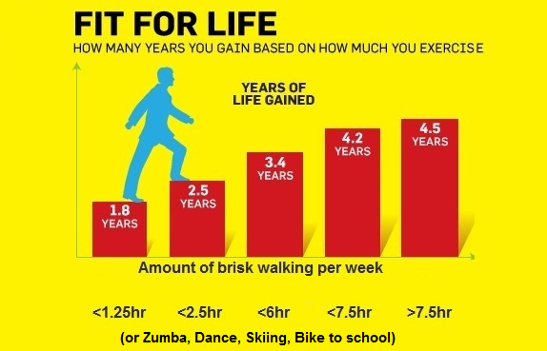

Slide 63
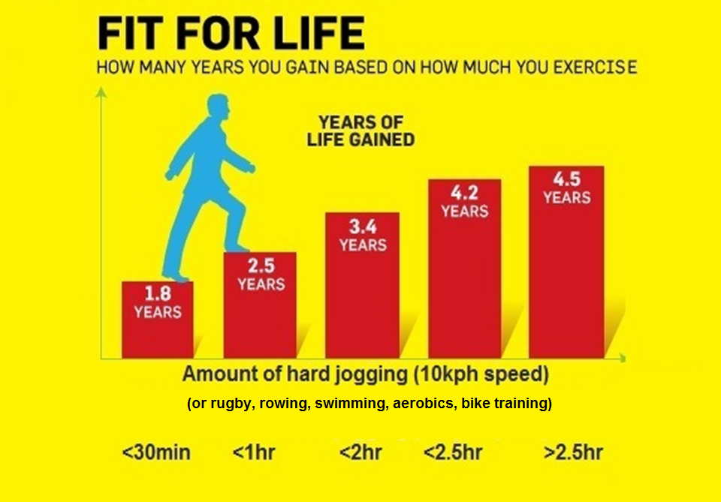

Slide 64
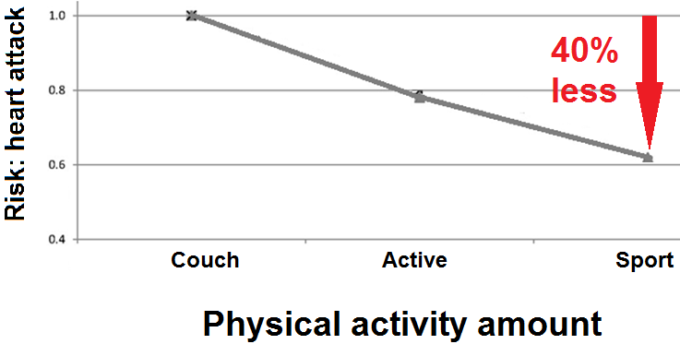
and the harder you exercise the better
Women; Shiroma E J , and Lee I Circulation 2010;122:743-752
Notes:
Figure 3. Median relative risks of CHD/CVD by dose of physical activity.

Slide 65
Exercise helps other health risks 70000 Nurses, age 40+ x 8 years; NEJM 650-8 August 26, 1999
FAT: Non-obese and very fit
→ 46% less MI than if lazy and obese
FAMILY: Family history of young MI + very fit
→ 42% less MI than if lazy
FAGS: Never-smoking and very fit
→ 85% less MI than lazy smoker (ex-smokers 81%!)

Slide 66
Your choice: get fitter → this will change your future health
7 studies show it!
1. Erikssen G., (1998) Changes in physical fitness and changes in mortality. Lancet 352:759-762
2. Manson J.E., (1999) A prospective study of walking as compared with vigorous exercise in the prevention of CHD in women. N.Engl.J.Med. 341:650-658
3. Paffenbarger R.S., (1994) Changes in physical activity and other lifeway patterns influencing longevity. Med.Sci.Sports Exerc. 26:857-865
4. Paffenbarger R.S (1993) The association of changes in physical-activity level with mortality among men. N.Engl.J.Med. 328:538-545
5. Wannamethee S., A.G.Shaper, M.Walker (1998) Changes in physical activity, mortality, and coronary heart disease in older men. Lancet 351:1603-1608
6. Lissner L., (1996) Physical activity levels and changes in relation to longevity. Am.J.Epidemiol. 143:54-62
7. Hein H.O., (1994) Changes in physical activity level and risk of ischaemic heart disease. Scand.J.Med.Sci.Sports 4:57-64

Slide 67
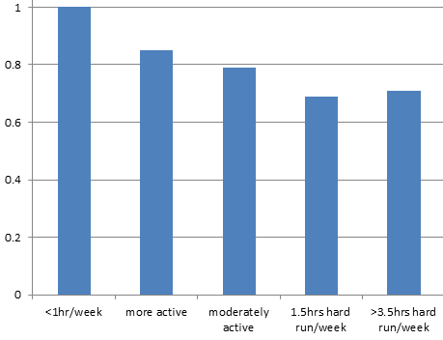
If you are a couch potato , but later take up exercise…
Followed up for 8 years your risk of heart attack is less
30% less!
Relative risk
P=0.03 for a trend
72000 Nurses,
NEJM 650-8 August 26, 1999
Still a couch potato

